Slide 1


4
th
International Symposium
One Health, One World
November 20-22, 2025
CSIR CBRI, Roorkee
Seismic Performance of Full-Scale Brick Masonry Buildings
Chourasia, Ajay (Speaker)
Bhattacharyya, S.K.
Bhandari, N.M.

Slide 2




Seismic Performance of Full-Scale Brick Masonry Buildings
Chourasia, Ajay et al.
Outline
Motivation
Vulnerability of Masonry Buildings
Experimental Framework
Methodology
Experimental Observations, Results & Discussion
Conclusion
CSIR-CBRI, Roorkee, India
20th-22nd Nov,2025
www.ohow2025.in

Slide 3
Seismic Performance of Full-Scale Brick Masonry Buildings
Chourasia, Ajay et al.
Motivation
85% Buildings in India – Masonry
Heterogeneous – Material Properties
Vulnerability of Masonry Buildings Demonstrated in Past
EQ
CSIR-CBRI, Roorkee, India
20th-22nd Nov,2025
www.ohow2025.in

Slide 4
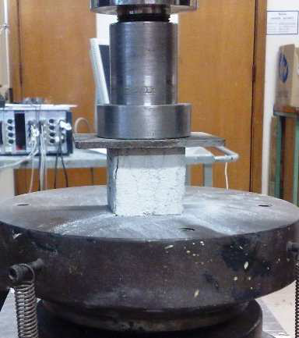
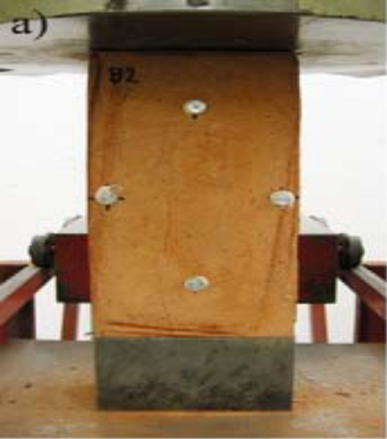
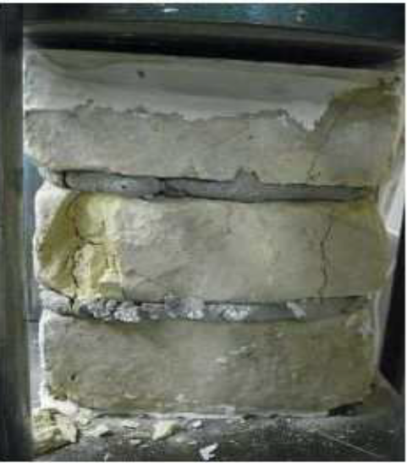
Seismic Performance of Full-Scale Brick Masonry Buildings
Chourasia, Ajay et al.
Framework
Results of 27 test programs………………………………….
…………………………………………….
…………………………………...
Mortar testing
(Derakhshan, 2011)
Brick testing
(Beyer & Dazio, 2011)
Prism testing
(Derakhshan, 2011)
CSIR-CBRI, Roorkee, India
20th-22nd Nov,2025
www.ohow2025.in

Slide 5
Seismic Performance of Full-Scale Brick Masonry Buildings
Chourasia, Ajay et al.
Methodology
Results of 27 test programs………………………………….
…………………………………………….
…………………………………...
Mortar testing
(Derakhshan, 2011)
Brick testing
(Beyer & Dazio, 2011)
Prism testing
(Derakhshan, 2011)
CSIR-CBRI, Roorkee, India
20th-22nd Nov,2025
www.ohow2025.in

Slide 6
Seismic Performance of Full-Scale Brick Masonry Buildings
Chourasia, Ajay et al.
Observations
The EC6 formulation…….
………….
………………..
………………………….
………………
CSIR-CBRI, Roorkee, India
20th-22nd Nov,2025
www.ohow2025.in

Slide 7


Seismic Performance of Full-Scale Brick Masonry Buildings
Chourasia, Ajay et al.
Results
Comparison between Experimental data and Formulations
Equation | DMI2008 |  | ‎EC6 | ‎Essenger | ‎Brӧcker | ‎Guidi | ‎Hilsdorf | ‎Francis et al | ‎Tassios 1983 | ‎Tassios 1985 | ‎Tassios 1988 | ‎Tassios 2004
 |  | 1.27 | 1.16 | 0.73 | 1.57 | 1.09 | 0.86 | 0.70 | 1.15 | 1.24 | 0.57 | 2.23
 |  | 0.39 | 0.41 | 0.45 | 0.43 | 0.52 | 0.41 | 0.48 | 0.39 | 0.42 | 0.44 | 0.48
R² |  | 0.71 | 0.80 | 0.06 | 0.53 | 0.64 | 0.65 | 0.08 | 0.74 | 0.77 | -1.90 | -0.20
% of non-conservative cases |  | 34.3 | 38.6 | 84.3 | 21.4 | 51.4 | 74.3 | 82.9 | 38.6 | 37.1 | 97.1 | 14.3
The EC6 formulation…….
………….
………………..
………………………….
………………
CSIR-CBRI, Roorkee, India
20th-22nd Nov,2025
www.ohow2025.in

Slide 8
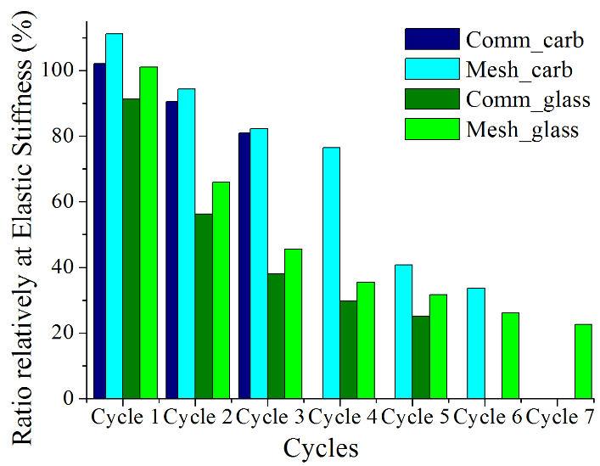
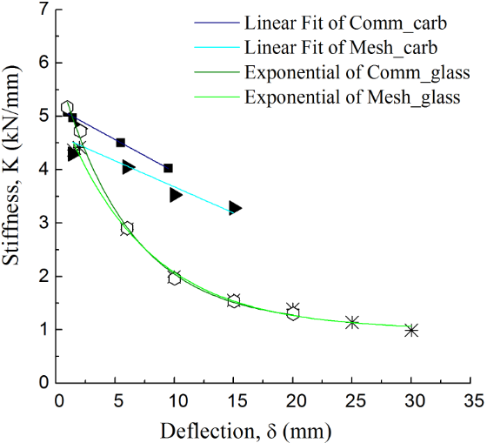
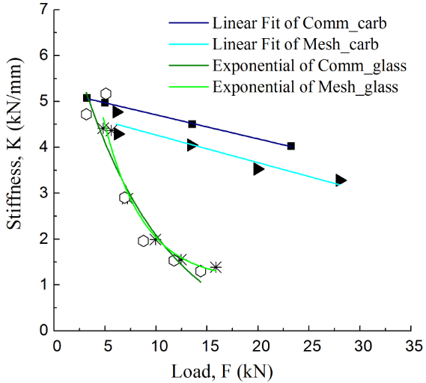
Seismic Performance of Full-Scale Brick Masonry Buildings
Chourasia, Ajay et al.
Discussion
Comparative Analysis
A “strong” unit (fj / fb < 0.25) the
……………………….
K = 5,17- 0,12δ
K = 4,66-0, 10δ
K = 0,39 + 4,31×exp(-0,14δ)
K = 1,10 + 4,90×exp(-0,16δ)
K = 5,23- 0,05F
K= 4,87- 0,06F
K= 1,10 + 12,32×exp(-0,26F)
K= -0,47 + 8,19×exp(-0,12F)
CSIR-CBRI, Roorkee, India
20th-22nd Nov,2025
www.ohow2025.in

Slide 9
Seismic Performance of Full-Scale Brick Masonry Buildings
Chourasia, Ajay et al.
Conclusions
CM building exhibited higher strength and ductility
…
………
…………
CSIR-CBRI, Roorkee, India
20th-22nd Nov,2025
www.ohow2025.in

Slide 10
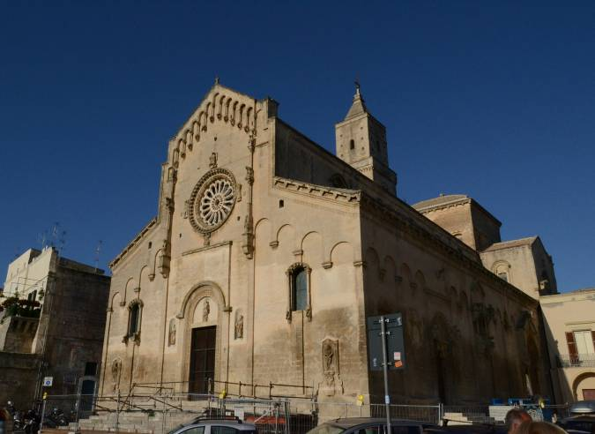
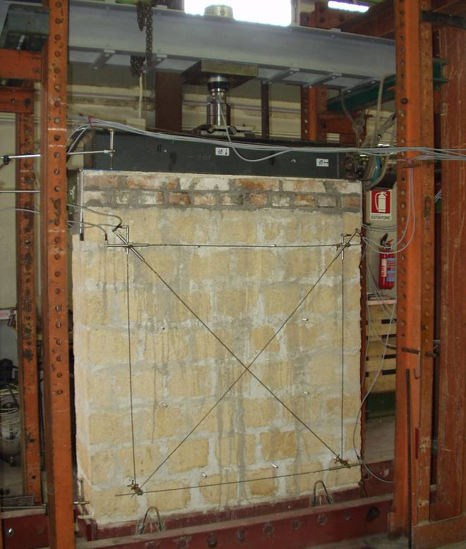
Seismic Performance of Full-Scale Brick Masonry Buildings
Chourasia, Ajay et al.
Future Work
Additional analyses are necessary to….
…..
………
Madonna della Bruna and Sant'Eustachio’s Cathedral, Matera - Italy
CSIR-CBRI, Roorkee, India
20th-22nd Nov,2025
www.ohow2025.in

Slide 11
Seismic Performance of Full-Scale Brick Masonry Buildings
Chourasia, Ajay et al.
THANK YOU …
CSIR-CBRI, Roorkee, India
20th-22nd Nov,2025
www.ohow2025.in

